Slide 1

QR Code Based Passport Identification.
Project Title:
Smt. Kashibai Navale College of Engineering
Department of Electronics and Telecommunication
Project Group Number: A25
Name of students :
BA073 : Sayali Satpute
BA074 : Neha Zodge
BA075: Sayali Chavan
Guided by:
Prof. N.R.Bamane
E&TC Dept.

Slide 2
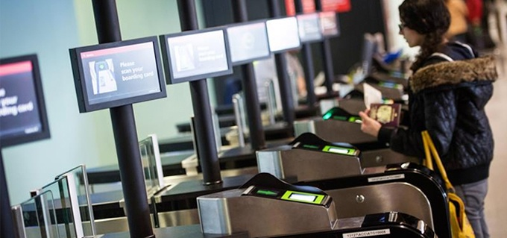
Introduction
To avoid Various a type of crime and to maintain security this system is designed.

Slide 3
Abstract
Security and authenticity of data is a big challenge.
Details listed in a passport will be encoded in QR Code in encrypted form.
The data can be retrieved from the QR code and can be decrypted at the receiver side.
This technique will be demonstrated on Passport to verify the details listed in the Passport.

Slide 4
Objectives :
Identifying person in different stages
Counting the number of persons according to their nationalities.
Identifying Language.
Access Control

Slide 5
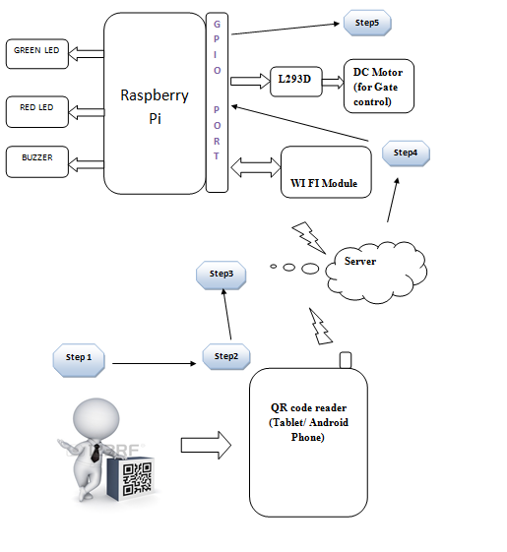
Block Diagram

Slide 6

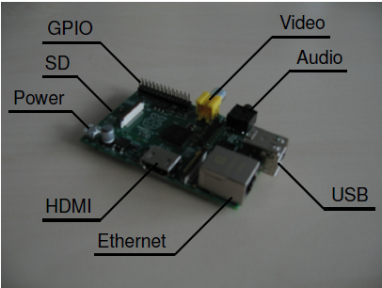

Raspberry Pi
The Raspberry Pi-2 Model B (BCM2836) is a series of credit card –sized single board computers
Hardware :

Slide 7

Quick Response (QR) code
Two-dimensional bar codes that can contain any alphanumeric text
omnidirectional scanning
Fast
High-capacity data storage
Small size
Error correction

Slide 8
Algorithm
Start
Initialize the camera of the android phone
Read the input of the camera as QR code image
Apply decoding algorithm of the QR code and send the decoded id from the QR code to the raspberry pi via wifi
Server is running on the raspberry pi
Server will receive the QR code of the person via wifi check in the database and will show his/her photo id
When authorized person present in the room see that information is correct or not
If the information is correct, gate opens
If information is wrong ,buzzer will get activated

Slide 9
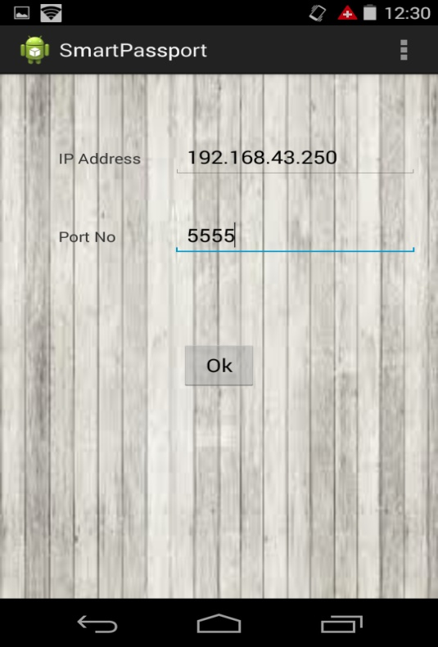
Client

Slide 10
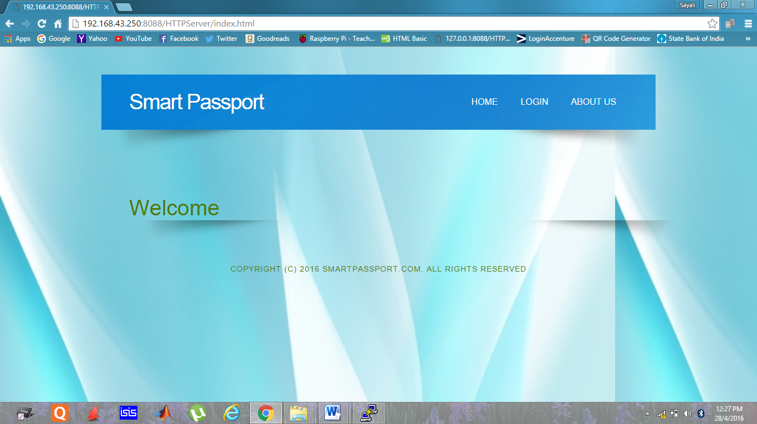
Server
http://192.168.43.250:8088/HTTPServer

Slide 11
Advantages
Reduces human affords for checking every person
Fast process
Provide Security from any danger

Slide 12
Applications
• Manufacturing
• Warehousing and logistics
• Retailing
• Transportation
• Office automation
• Marketing and advertising
• Healthcare

Slide 13
Conclusion
The proposed method will be used to demonstrate on a sample passport to verify the passport text details. Therefore we choose a QR code based password identification which reduces the human work and efforts. Only admin is able to use the database related problems and changes. Only valid person can enter after verification, and it needs very less time and efforts. Security level is increased in this system as QR code having with each person as a valid ID.

Slide 14
FUTURE SCOPE
To increase the security at airports- hex key pad by which user can enter his password.
Interfacing the system with a GSM module.

Slide 15
References
https://www.raspberrypi.org/
International journal of advanced electronics & communication systems approved by csir-niscair issn no: 2277-7318 proceedings of international conference on modeling and simulation in engineering & technology (icmset-2014) 15th - 16th february, 2014
Wikipedia", http://en.wikipedia.org/wiki/QR_code

Slide 16
Thank You!

